Slide 1

Student Performance Analysis Using Multiple Linear Regression
Regression Analysis
SAID ALI AHMED
2025/09/06

Slide 2
Objective:
Understand factors influencing student performance
Variables considered:
Hours Studied
Previous Scores
Extracurricular Activities
Sleep Hours
Sample Question Papers Practiced
Target variable: Performance Index

Slide 3

ANALYSIS PROCESS
Data Preparation
1
Exploratory Data Analysis
2
3
Correlation Analysis
4
Model Summary
Interpretation
5

Slide 4
DATA LOADING & CLEANING
Previewed & inspected data:
Checked missing values
Encoded categorical variable(yes or NO → 1, No → 0
Checked duplicates

Slide 5
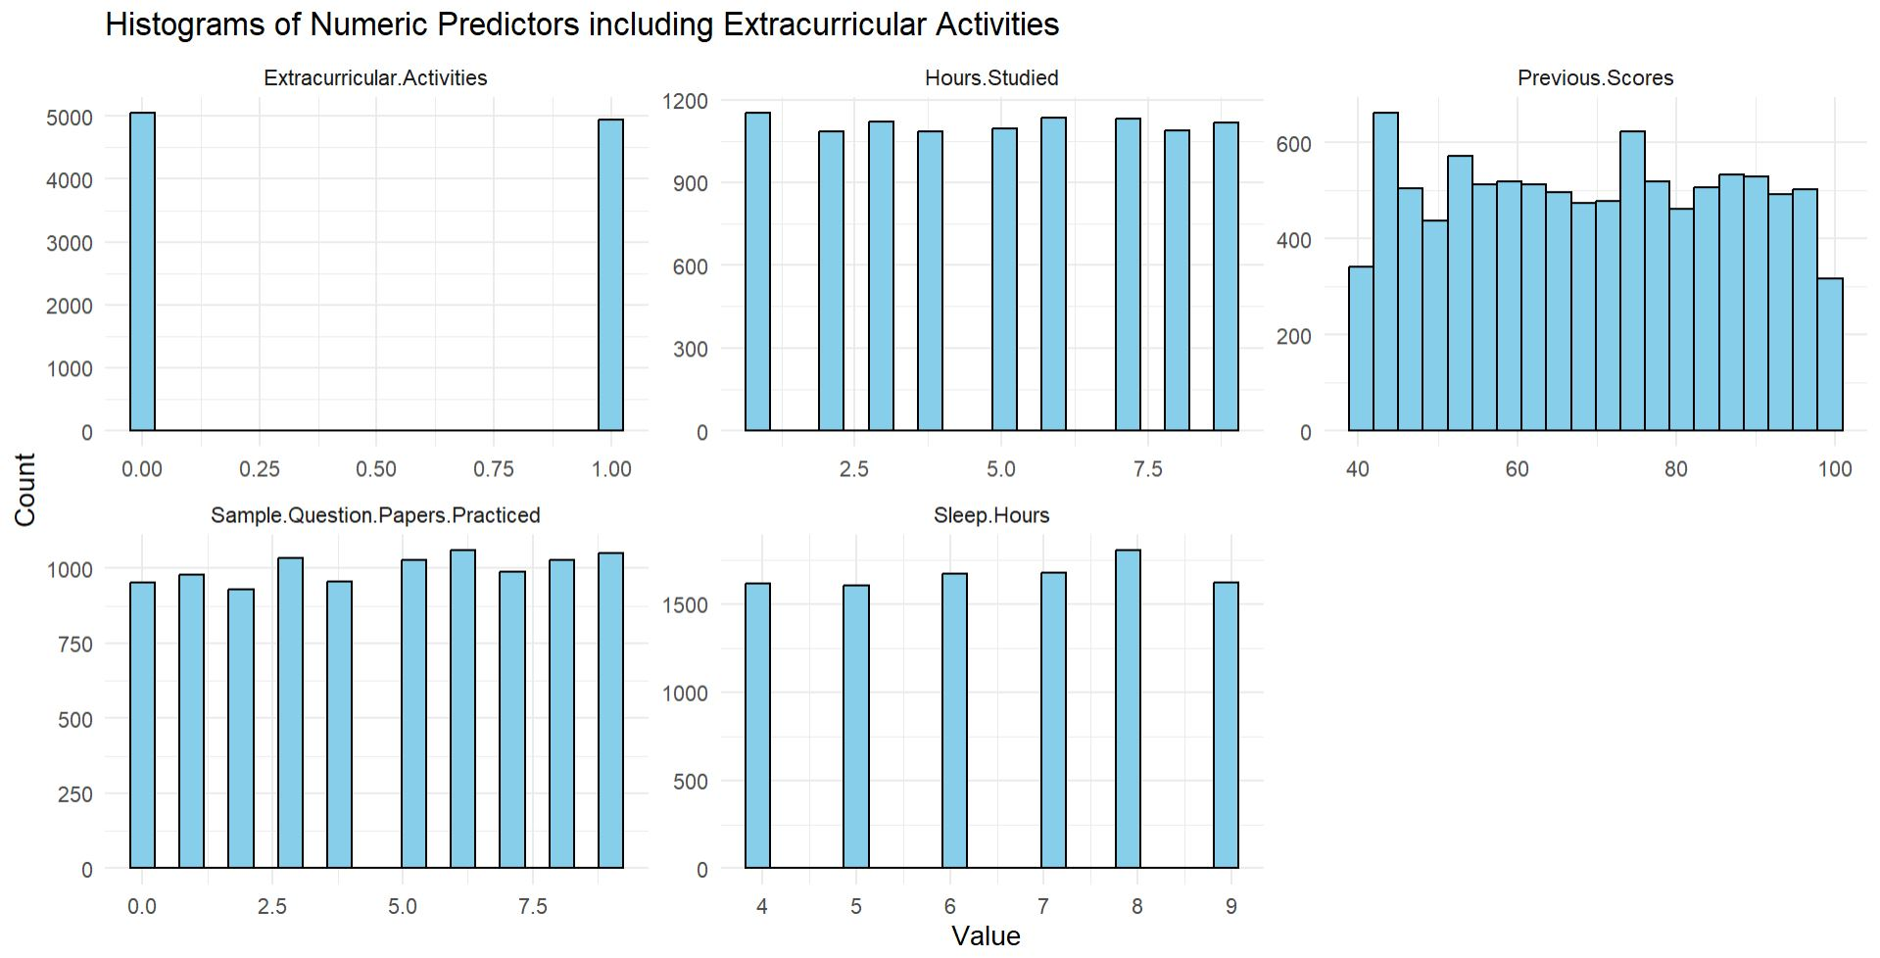
Exploratory Data Analysis – Histograms
Summary:
→ The numeric predictors are mostly uniformly distributed, with extracurricular activities being binary, sleep hours peaking slightly at 8, and previous scores showing minor variability across their range.

Slide 6
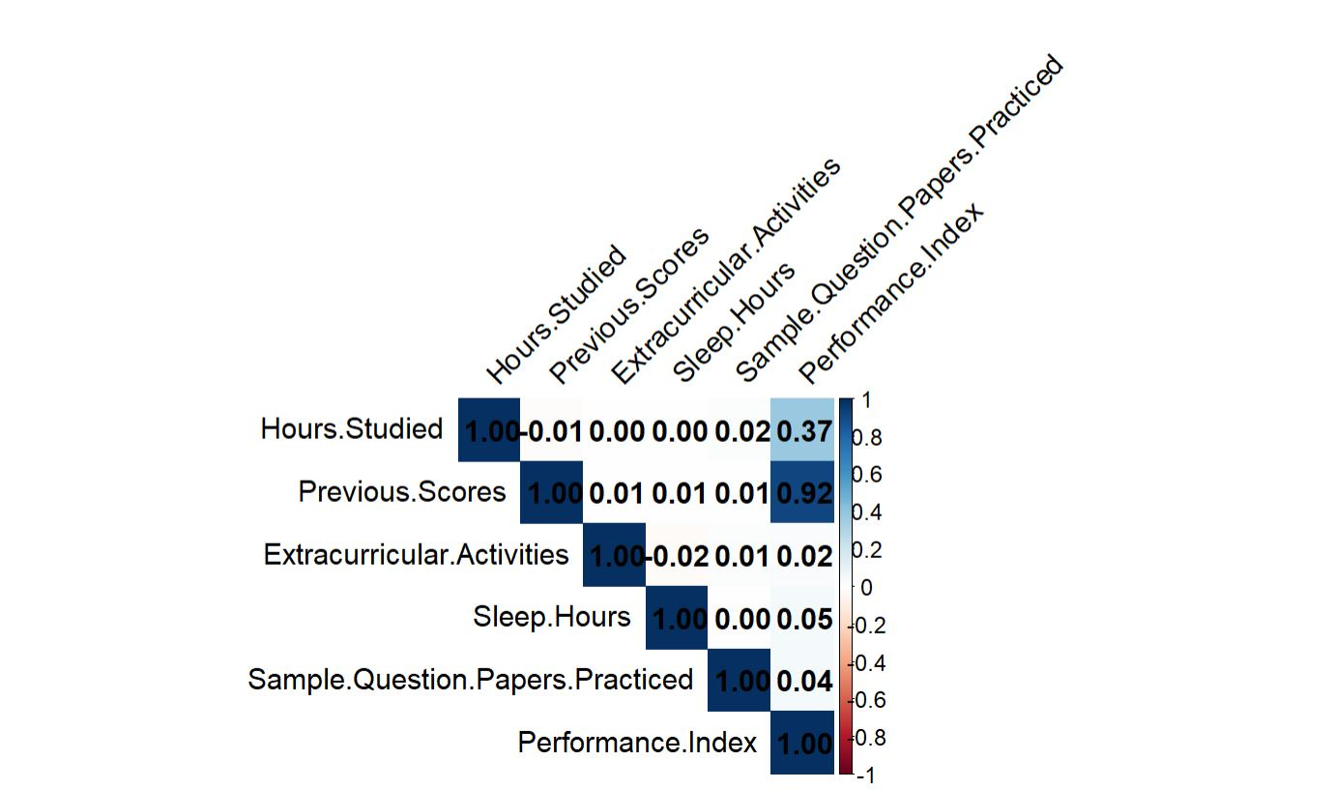
CORRELATION ANALYSIS
Summary:
Based on this analysis, a student's previous academic scores are by far the strongest predictor of their current performance. The amount of time spent studying is also a relevant factor, but to a much lesser degree. The other measured factors (extracurricular activities, sleep, and practicing sample papers) show no meaningful statistical relationship with performance in this dataset.

Slide 7
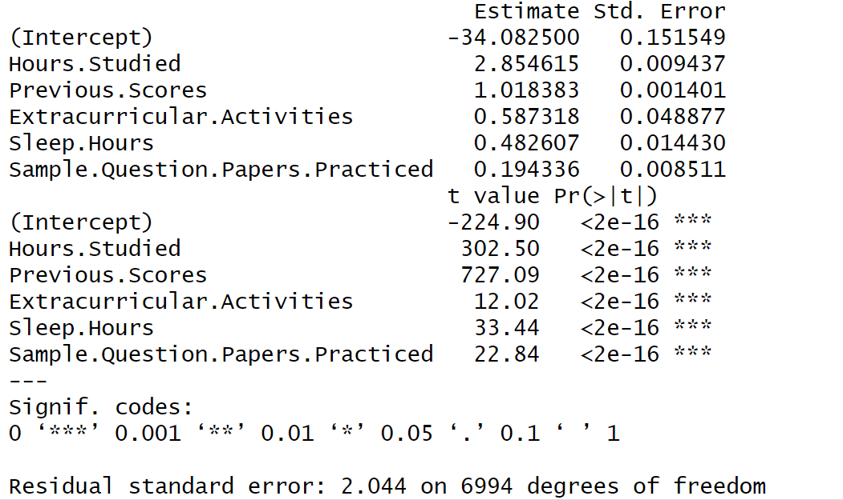
Model Summary
MODEL SUMMARY
Dependent Variable: Performance.Index
Predictors: Hours.Studied, Previous.Scores, Extracurricular.Activities, Sleep.Hours, Sample.Question.Papers.Practiced
Model Fit:
R-squared = 0.9889 → ~98.9% of variance explained
Adjusted R-squared = 0.9889
Residual Standard Error ≈ 2.04
F-statistic = 1.25e+05, p < 2.2e-16 → model is highly significant
Significant Predictors (p < 0.001):
Hours.Studied (β ≈ 2.85)
Previous.Scores (β ≈ 1.02)
Extracurricular.Activities (β ≈ 0.59)
Sleep.Hours (β ≈ 0.48)
Sample.Question.Papers.Practiced (β ≈ 0.19)

Slide 8
Interpretations
Students who study more hours and have higher previous scores tend to achieve a higher Performance. Index.
Participation in extracurricular activities, adequate sleep, and practicing sample question papers also positively influence performance, though their effect is smaller compared to study hours and previous scores.
The model fits the data very well, with low residual error, indicating accurate predictions of student performance.

Slide 9
Thank you

